Slide 1


First Model
Breakdown.

Slide 2
What is the difference between an architecture and a model in neural networks?

Slide 3
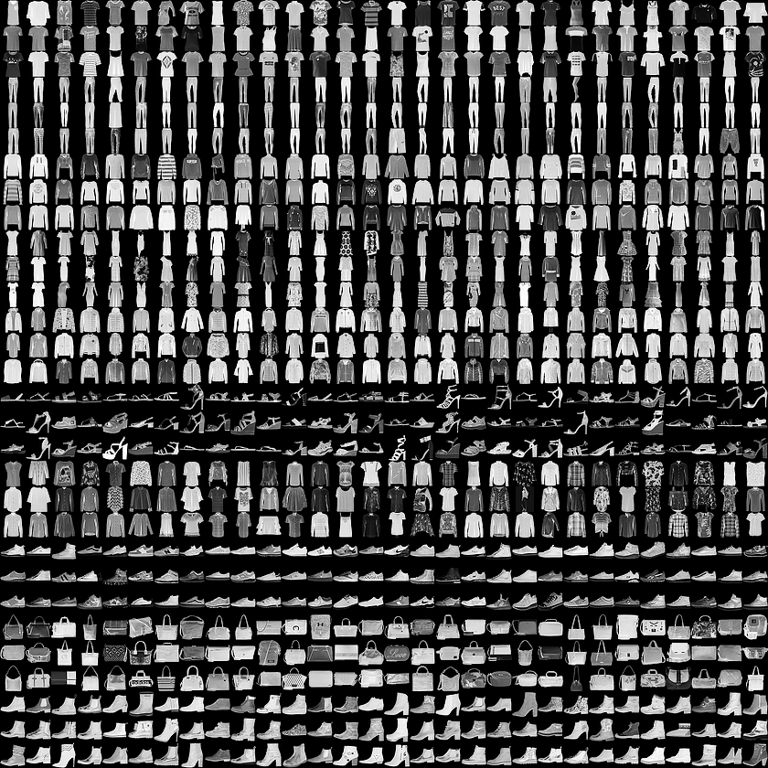
First Model Basics
Fashion MNIST Dataset
Consists of images of clothing of size
28 * 28 pixels.
Images are in grayscale.
Images make up 10 classes – Tshirt / Top,
Trouser, Pullover, Dress, Coat, Sandal,
Shirt, Sneaker, Bag and Ankle Boot.
Notes:
Jedidah

Slide 4
Steps In Training A Neural Network
Load and Preprocess Our Data.
=> Split the Data into Training, Validation and Testing datasets.
=> Define Our Dataset Object.
=> Define Our transforms
=> Apply the transforms on Our Dataset
=> Define our Data loader object
=> Create an iteration loop over the Data Loader
Build Our Network Architecture.
Train Our Network.
=> Instantiate our model.
=> Define our Loss function
=> Define our Optimization function
=> Train the Network.
=> Save the trained model.
Test the Network.
=> Load the saved model.
=> Test it on the test dataset.
Notes:
Jedidah

Slide 5
Loading and Preprocessing our Data

Slide 6
Splitting the Data.
Split the Data into a training, validation and testing set.
=> Ensures that we can validate and test the model on new and unseen data.
=> Split is usually on a (0.8, 0.1, 0.1) or (0.6, 0.2, 0.2) split, or anything in
between, with the training set taking the larger chunk.

Slide 7
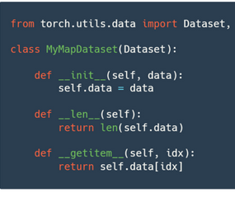
Define the Dataset object.
Stores data samples and their labels.
Helps us get information about the data we are working with easily. E.g. Length of the dataset,
functions to get a specific data from the dataset
etc.
Custom dataset objects must contain the following methods:
=> __init__ method,
=> __len__ methods,
=> __getitem__ method
Documentation on the Pytorch Dataset object can be found here.

Slide 8
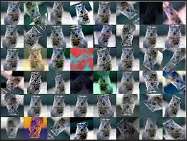
Defining Our Transforms.
Used to add variety to our data.
Applied on the dataset object.
Documentation on transforms can be found here.
Two important transforms:
=> To Tensor
=> Normalize
Other Transforms include:
=> Random Resized Crop
=> Centre Crop
=> Rotation
=> Color Jitter
=>Horizontal and Vertical flip

Slide 9
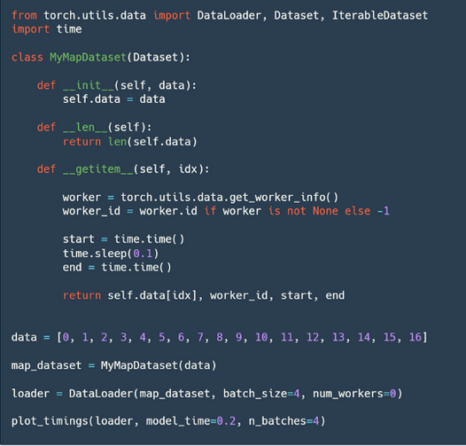
Define our Data Loader.
Creates a python iterable over a dataset.
Its functions include:
=> Enables batching of data in the dataset object.
=> Enables sampling of data in the dataset.
=> Provides support for single or multi-process data loading.
=> Enables memory pinning.
=> Enables shuffling of data during data loading.
Documentation on Data Loaders can be found here.

Slide 10


Define our Iterator
Allows us to get a single image and its
corresponding label from the data loader
as shown below.

Slide 11
Building Our Network Architecture.

Slide 12
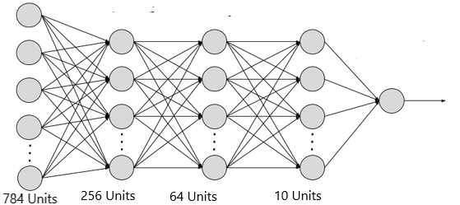
Building the Network Architecture.
Input is flattened. - Converted from an
n-dimensional tensor to a 1-D tensor and
form the input nodes.
Output nodes are defined based on the number
of classes to be predicted.
Hidden nodes, which map inputs to outputs are
defined.
An activation function for each node is defined.
A SoftMax function is applied across the output
classes to calculate the probability distribution.
Weights and biases for the network are initialized
randomly.

Slide 13
Training Our Model.

Slide 14
Training our Model
Instantiate our model.
Define our loss function. (Docs Here)
Define our optimizer function. (Docs Here)
Train the network. – This involves:
=> Make a forward pass through the model.
=> Calculate our loss.
=> Perform a back pass to calculate our gradients.
=> Take an optimizer step to update our parameters.
Save the model for inference.

Slide 15
Testing Our Model.

Slide 16
Testing the Model.
Load the model from storage.
Flatten the tensor data in the testing dataset.
Pass each data object through the network.
Get the top most class returned by the model
Compare the returned class to the label of the
data object passed.
Count all the correctly classified data objects
and use that to calculate the accuracy of the
model.

Slide 17
THE END!

